Slide 1
Housing Price Project
Prepared By:
SNEHA SANTRA

Slide 2
MODELS COMPARISION
Preventive
Measures
CONCLUSION
Solution Process
Key Findings
MODEL BUILDINHG
Problem Overview
AGENDA

Slide 3
Problem Overview
Houses are one of the necessary need of each and every person around the globe and therefore housing and real estate market is one of the markets which is one of the major contributors in the world’s economy. It is a very large market and there are various companies working in the domain. Data science comes as a very important tool to solve problems in the domain to help the companies increase their overall revenue, profits, improving their marketing strategies and focusing on changing trends in house sales and purchases. Predictive modelling, Market mix modelling, recommendation systems are some of the machine learning techniques used for achieving the business goals for housing companies. Our problem is related to one such housing company.

Slide 4

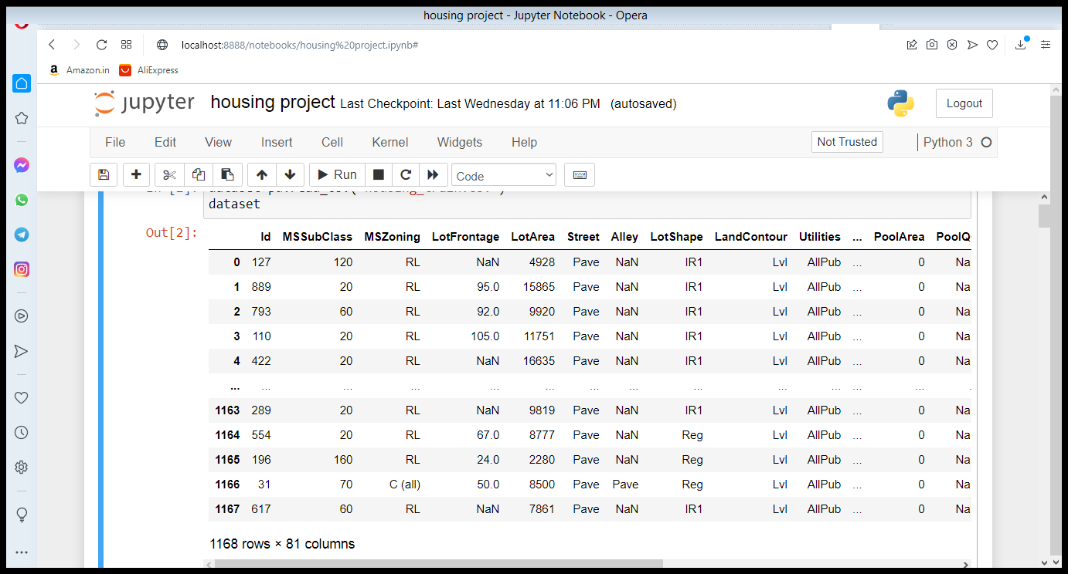



Solution Process
Model Validation
Model Performance measure on
testing data
Dataset is provided by flioprobo technology
Dataset is housing price prediction .There are 81 columns and 1460 intities.and we are observed the sale price and sale condition of the house.
STEP
04
Model Preparation
We teach the model
on Training dataset,
STEP
03
Analytical approach
Supervised Machine Learning problem,
Two class Classification,
STEP
02
Analyse Data
Heterogeneous population, Anomaly Treatment, Missing Values Treatment, creating new variable
STEP
01

Slide 5








Key Insights
The most important factors that influence the problem
YearBuilt
Sale price
YearRemodAdd
LotArea
GarageYrBlt
LotFrontage
MSSubclass
OverallQual

Slide 6
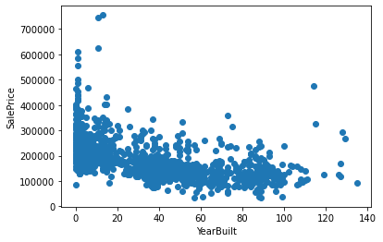
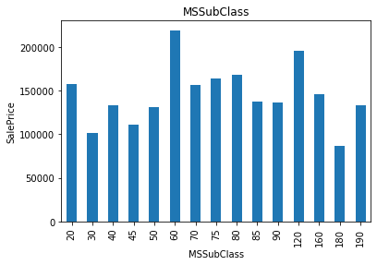
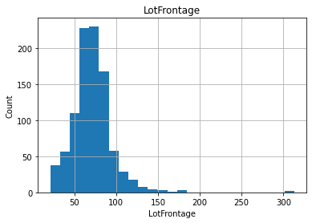
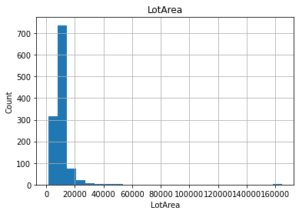
Preventive 5
Preventive 2
Preventive 3
Preventive 4
Preventive 1
Preventing Measures

Slide 7
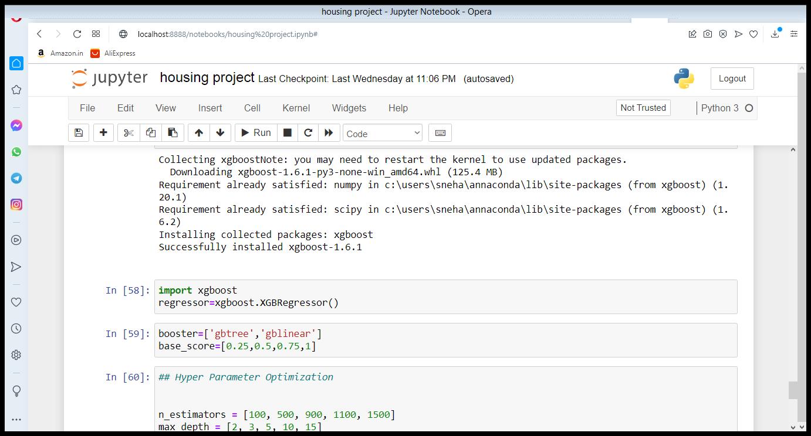
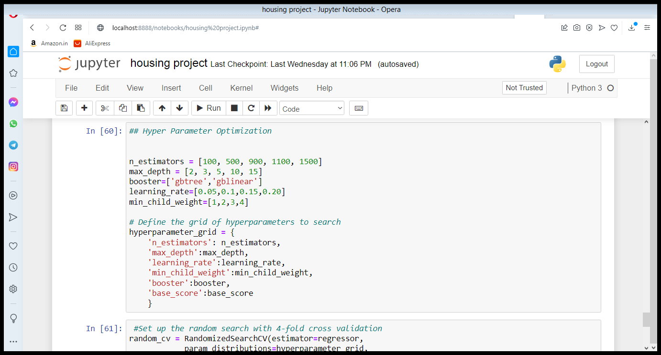
Model Building
Xgboost Classifier
Xgboost Regressor
And We choose Classifier for the model building and save it for better accuracy

Slide 8
CONCLUSION
Key Findings and Conclusions of the Study
After the Final Submission of test data, my accuracy score is good. Feature engineering helped me increase my accuracy.
Amazingly xgboost classifier worked better than all other Ensemble models.
Learning Outcomes of the Study in respect of Data Science
Data science comes as a very important tool to solve problems in the domain to help the companies increase their overall revenue, profits, improving their marketing strategies and focusing on changing trends in house sales and purchases. Predictive modelling, Market mix modelling, recommendation systems are some of the machine learning techniques used for achieving the business goals for housing companies. Our problem is related to one such housing company.

Slide 9
THANK YOU

